Slide 1
Facilitator Feedback
Information

Slide 2
Facilitator Feedback Information
Thank you for filling in the feedback information. The information provided will be shown on the website and will be used to:
Show others the benefit of running the workshops
Continuously improve the Circular Economy Toolkit and future workshops
Start filling in the feedback information from slide 9, replacing the blue text. Feedback should not take any longer than15 minutes. Once complete, please e-mail to: jle38@cam.ac.uk

Slide 3
Example
Workshop 1
Example Feedback

Slide 4
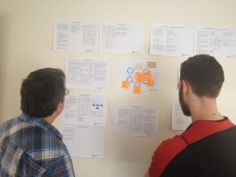
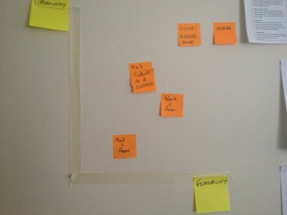
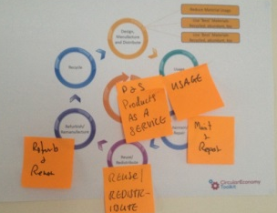
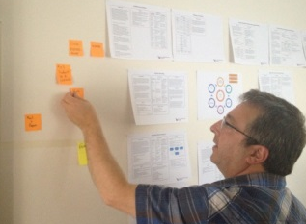
Example

Slide 5
Example
“I’m amazed at how many opportunities we found”
“There’s opportunity everywhere”

Slide 6





Example
OPPORTUNITY
FEASIBILITY

Slide 7
Example
5 Genuine opportunities identified
Next steps taken on top 2:
Lifetime energy costs showed a design change would reduce electricity bills for the customer and give competitive advantage
Facilitating the second hand market would invite new customers and compete with cheaper rivals

Slide 8
Your workshop feedback…

Slide 9
Type the product category
discussed in your workshop

Slide 10
Add pictures from your own workshop

Slide 11
“Quote 1”
“Quote 2”

Slide 12







OPPORTUNITY
Place the top 5 opportunities on the graph using the icons at the top
FEASIBILITY

Slide 13
X Genuine opportunities identified
Brief description of the top opportunities found:
Detail for first opportunity
Detail for the second opportunity
Detail for the third opportunity

Slide 14
Facilitator Feedback (1/2) please provide bullet points:
1. Want went well in the workshop:
XYZ
XYZ
XYZ
2. What could have gone better in the workshop:
XYZ
XYZ
XYZ
3. What materials/further information would have been useful to help you:
XYZ
XYZ
XYZ

Slide 15
Facilitator Feedback (2/2) please provide bullet points:
4. What are the next steps following the workshop:
XYZ
XYZ
XYZ
5. What materials/information would be useful to help your next steps:
XYZ
XYZ
XYZ

